Slide 1
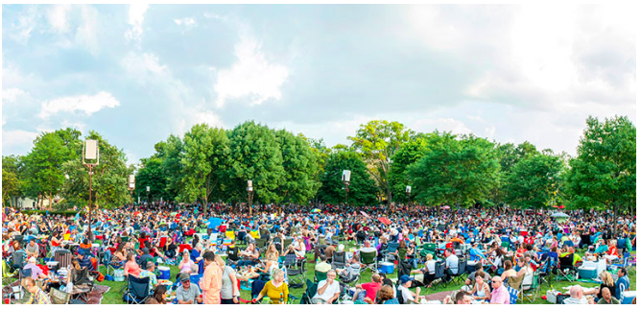
Sponsorship Opportunities
For Partnership Inquiries, contact Marla Camins at info@ebarts.org

Slide 2
Partner With Us For East Brunswick’s Future
The East Brunswick Arts Coalition is dedicated to enhancing the quality of life for all who live, work and shop in East Brunswick. The EBAC promotes a wide range or arts, cultural and historical events in our town. Our first event, ”The Summer Stage Under the Stars” series, kicks off with a six-night, family-friendly performance of FOOTLOOSE…
We hope we can count on your support!
Help Us Launch Our First Program
The East Brunswick Arts Coalition is a New Jersey nonprofit corporation. Application for 501(c)(3) status is pending.”
Notes:
The East Brunswick Arts Coalition is a New Jersey nonprofit corporation. Application for 501(c)(3) status is pending.”

Slide 3
Sponsorship Opportunities
Be Part of East Brunswick’s First Outdoor Performance Festival
Sponsorship Opportunities
JULY 25, 26, 27
AUGUST 1,2,3
(Rain date Aug. 4)
EAST BRUNSWICK, NJ

Slide 4
SPONSORSHIP PACKAGES
Join The East Brunswick Arts Coalition In Sponsoring its first “Summer Stage Under The Stars” production of FOOTLOOSE…presented By East Brunswick’s award-winning community theater, Playhouse 22!
Sponsorship Opportunities
WHY PARTNER WITH THE COALITION
Sponsorship of EBAC’s first-annual “Summer Stage Under The Stars” production of FOOTLOOSE offers a high visibility, cost-effective way to place your company's name before thousands of Middlesex County residents. Plus, you’ll receive year-round recognition in all EBAC-sponsored programming
Who’ll You’ll Be Reaching
Audience: Est. 250,000 (local target) impressions via digital landing pages, emails, social media & publicity outreach
Attendees: We expect 2-3,000 people to attend the six day event
From: East Brunswick, Milltown, South Brunswick, North Brunswick, Monroe (Middlex Cty.)
(Typically, 67% of attendees will travel from within 15 miles to festival events)
East Brunswick Resident Specs:
Population (2017): 48,840
Educational Attainment (2012-17) Bachelor’s degree or higher: 25+53.4%
Median Household Income : (2012-16) $101,435
Median Value of Owner-Occupied Housing: (2012-17) $379,800
Be Part of East Brunswick’s First Outdoor Performance Festival

Slide 5
SPONSORSHIP PACKAGES
Join the East Brunswick Arts Coalition in sponsoring its first “Summer Stage Under The Stars” production of FOOTLOOSE…Presented By Playhouse 22! Best Value in Town: Get sponsored by two great organizations: East Brunswick Arts Coalition & Playhouse 22 – for just 1 sponsorship!
When you invest with us, we invest in you…
Sponsorship Opportunities
DETAILS:
Where:
East Brunswick Ampitheater at the Community Arts Center,
Cranbury Rd., East Brunswick
When: July 25, 26, 27
Aug 1, 2,3
Raindate: Aug. 4
Doors Open:
Nightly at 6 pm
Show starts at 8 pm
Tickets: $7 each
(Kids 5 & under free)
Buy tickets/get info:
FootlooseEB.com
WHY PARTNER WITH US?
Your sponsorship offers your company tremendous visibility, promotion and access to local residents. With expected attendance of more then 3,000 local, plus thousands more online impressions via email, social media and press activities, the Summer Stage festival provides the perfect chance to connect with local families with a passion for performing arts and their community.
Be Part of East Brunswick’s First Outdoor Performance Festival

Slide 6
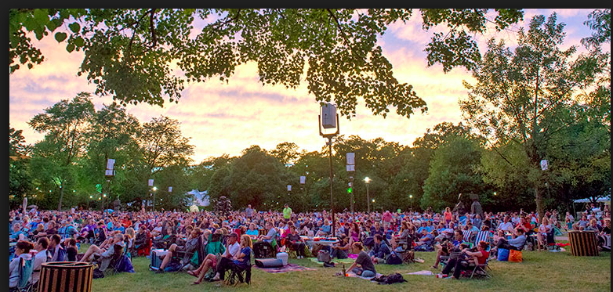
Choose From 3 Founding Member Top-Tier Corporate Sponsorships
Platinum
Only 4 will be accepted + Exclusive Category
Investment level: $10,000
Your Logo on:
Rt. 18 billboard advertising*
On-site banners/signage
Playbill full page
Show T-shirts worn by staff, ushers, etc..
Pre-show emails blasts, social media, digital landing pages, flyers, posters
EBAC booth/collateral/digital assets
Your company acknowledged before start of each show
35 Comp. tickets to show
10 Reserved Parking Spots
Participation Deadline: June 30
* An estimated 100,000 commuters will travel past this sign daily
Gold
Investment level: $5,000
Your Logo on:
On-site banners/signage
Playbill half page
Show T-shirts worn by staff, ushers, etc..
Pre-show emails blasts, social media, digital landing pages, flyers, posters
Your company acknowledged before start of each show
16 Complimentary tickets to show
5 Reserved Parking Spots
Participation Deadline: June 30
Silver
Investment level: $2,500
Your Logo on:
On-site banners/signage
Playbill 1/4 page
Show T-shirts worn by staff, ushers, etc..
Pre-show emails blasts, social media, digital landing pages, flyers, posters
Your company acknowledged before start of each show
6 Complimentary tickets to show
2 Reserved Parking Spots
Participation Deadline: June 30

Slide 7
Become an EBAC Business Founding Member
Founding Business Partner: *
Investment: $125
Your Company Name/Logo Featured:
On the online Playbill
Website link on EBAC online landing page
EBAC Email blasts
EBAC - social media posts and activations
Participation Deadline: June 30, 2019
Restaurants
Investment: $225
Your Company Name/Logo Featured:
On the online Playbill
Website link on EBAC online landing page- restaurant directory
EBAC Email blasts
EBAC - social media posts and activations
Participation Deadline: June 30, 2019
*10% Discount for East Brunswick Regional Chamber Members

Slide 8
East Brunswick Arts Coalition
www.EBArts.org
For more information call: (732) 390-6810
Dana Winston At DanaMWinston@gmail.com
Marla Camins at MarlaCamins@aol.com
Kim Conetta at KConetta@comcast.net
Thank You!

